Slide 1


SESSION on PYTHON
By Aditya Tripathi

Slide 2

Aditya Tripathi
Co-founder and CEO of Coder Mask Pvt. Ltd.
I am an Data Scientist and A.I. Expert.
I’ve been in training industry for 3 years and has taught over 10,000’s engineering graduates, 1000’s of non-technical/non-engineering graduates.
Working as a freelance developer for
Coding Brain
Dyotis Technologies

Slide 3


WHAT IS COMPUTER SCIENCE?
Fig. How human brain works?
Computer Science
Fig. How computer works?

Slide 4
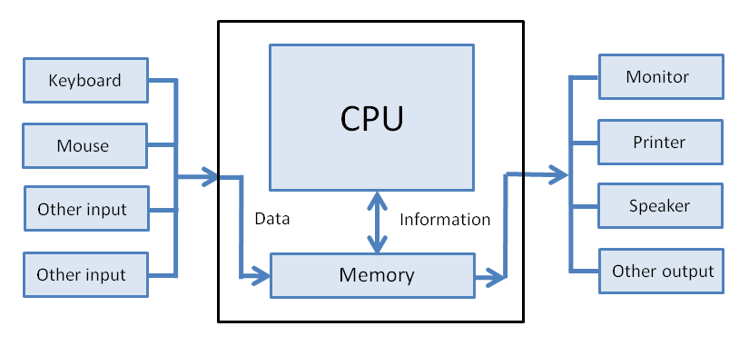
DETAILED VIEW

Slide 5
Human-Computer Interaction
As a Human we better understand high level language such as English, French, Hindi etc.
Computer understand only low level language(machine language) i.e. 0(No-Signal) & 1(Signal).
Hence to make human language to be understood by machines we need to convert it to machine language.

Slide 6
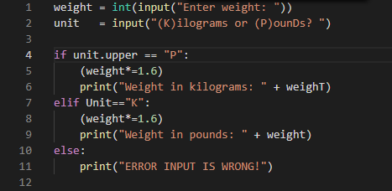
What is Program?
In simple terms, program is a set of logically built instructions.

Slide 7

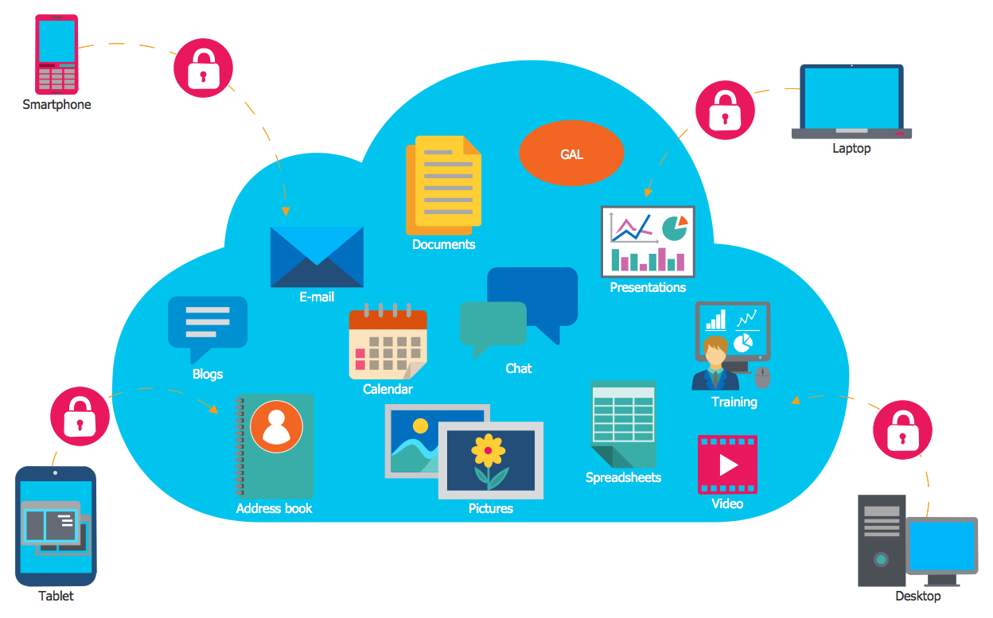
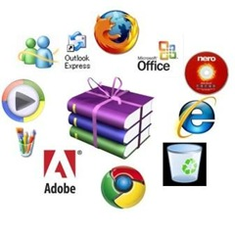
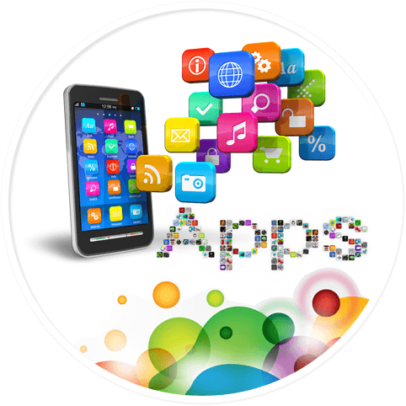
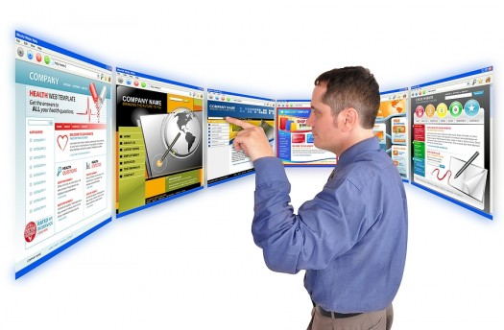
Why Programming ?
In the daily life of the digital world, we use
all are possible because of programming.
Programming is important to create software and application.
Due to all these reasons, it's really important to learn how to use programming in our daily life.

Slide 8
What is Programming?
Programming is the implementation of logic to facilitate specific computing operations and functionalities.
Programming is the process of preparing an instructional program for a device.
In simplest term, programming is an attempt to get a computer to complete a specific task without mistake.
Programming can be done in one or more languages, which differ by application, domain and programming model.

Slide 9
Why so many programming languages?
Year | Language | Purpose
1957 | FORTANE | FORmula TRANslation is a compiled imperative programming language especially suited to numeric computation and scientific computing.
1959 | COBOL | COmmon Business Oriented Language is a compiled computer programming language designed for business use.
Mid-1960’s | BASIC | Beginners' All-purpose Symbolic Instruction Code is a general-purpose, programming languages whose design philosophy emphasizes on ease of use.
1972 | C | C is a procedural programming language, initially developed by Dennis Ritchie. It was mainly developed as a system programming language to write an operating system.

Slide 10
continues...
Year | Language | Purpose
1980 | C++ | C++ is a cross-platform language that can be used to create high-performance applications. C++ was developed by Bjarne Stroustrup.
 | ABC | ABC is an interactive programming language and environment for personal computing, originally intended as a good replacement for BASIC.
1991 | PYTHON | Python successor of ABC is an interpreted, general-purpose programming language. Created by Guido Van Rossum.
1995 | JAVA | Java is a set of technologies (programming language and computing platform) for creating and running software.

Slide 11
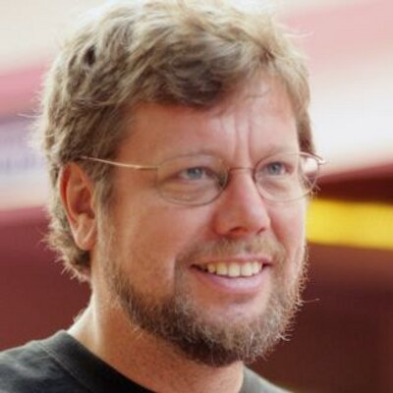
What is Python and history of Python?
Python is open source, general purpose programming language.
Python was initially designed by Guido Van Rossum in 1991 at Centrum Wiskunde & Informatica (CWI) in Netherlands and developed by Python Software Foundation.
Python is successor of ABC Programming Language.
The inspiration for the name came from BBC’s TV Show – ‘Monty Python’s Flying Circus’

Slide 12
Python Vs Other
Python was released in 1991 and has become one of the most popular programming language in the world nearly about 2006.
Java was released in 1995 in Sun Microsystem but had got 3 million devices quickly.
How??
Around 2006 Google started using Python heavily and reinvesting in development of Python.

Slide 13
Why to choose Python Programming ?
Python is the most trending programming language because of it’s application in Artificial Intelligence, Machine Learning and Data Science.
Python's design philosophy emphasizes code readability with its notable use of significant whitespace.
With python, we can create solutions quickly and others can understand them easily.
Because Python comes with a great standard libraries as well as open-source third party libraries. Hence mostly we don’t need to code from scratch, we can easily build-upon available code.

Slide 14

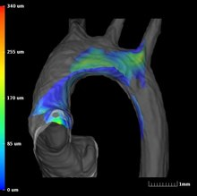
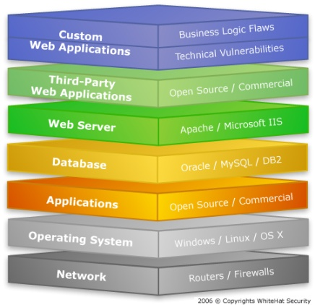

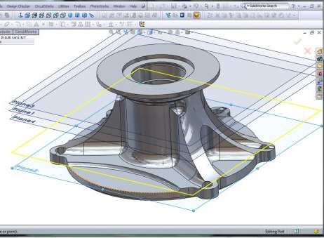

Applications of Python Programming
In Data Science and Analytics
In Scientific and Numeric Computing
In Web based applications
In Image Processing applications
In Audio or Video based applications
In Desktop GUI applications
In Software Development
In Business applications
In Console Based applications
In 3D CAD applications
In Cloud Configuration

Slide 15






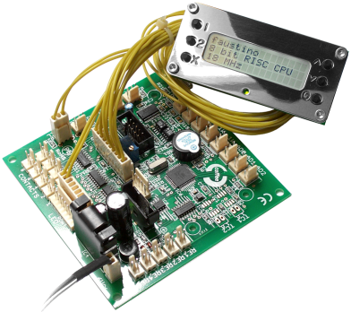


Companies using Python at large scale
Google
Facebook
Amazon
Instagram
Uber
IBM, HP, Qualcomm, Seagate
Spotify, Netflix

Slide 16
Features of Python
Simple and clear syntax
Interpreted language
Dynamic language.
Dynamically typed and strongly typed language.
Platform independent.
Multi-paradigm programming language such as imperative, procedural, object oriented.
Follows OOP concept.
Supports multithreading.

Slide 17
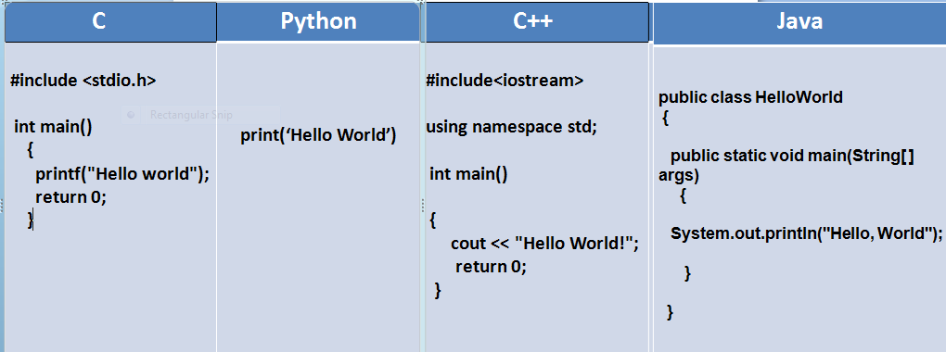
Code of Python Vs Others

Slide 18
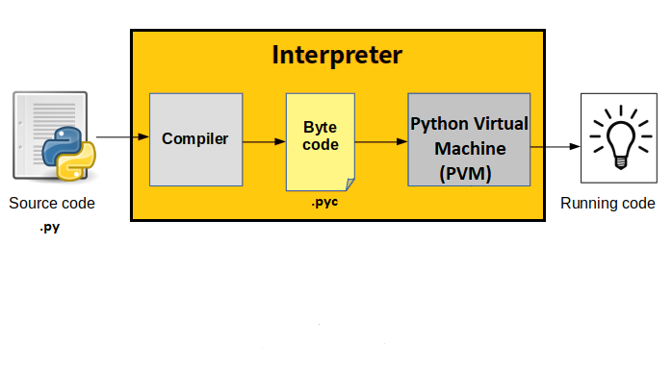
Python Architecture

Slide 19
What is Code Environment?
A code environment is a standalone and self-contained platform (environment) to run Python.
A code environment is a platform where we can write, run(convert to machine code) & execute our Python code and again convert back machine code to high level code.
There are 3 main types of code environment in Python:
Text Editor
Full IDE’s
Notebook Environment

Slide 20
Text Editor Environment
Text editors refers to source code editors in programming are software programs that enable the user to create and edit text files.
General editors for any text file.
Works with a variety of file types.
Can be customized with plug-ins and add-ons.
Popular Python Text Editors: VS Studio Code & Notepad++

Slide 21
Full IDEs(Integrated Development Environment)
Development environment enables a complete set for source code editor as well as debugging featured building tool.
Python IDE’s are designed specifically for Python.
Since designed for Python only, so have lots of extra functionalities such as code debugging etc.
Used for large program development.
Only community editions are free.
Popular Python IDEs: PyCharm & Spyder
Python Standard IDE: IDLE (Integrated Development Learning Environment)

Slide 22
Notebook Environment
Notebook environment is used for writing the code on the go and for seamless learning experience, where we can write our code and see the output side-by-side.
Great for learning.
See input and Output next to each other.
Support in-line markdown notes, tables, image, video etc.
Special file format that is not .py.
Popular Notebook Environment: Jupyter Notebook

Slide 23
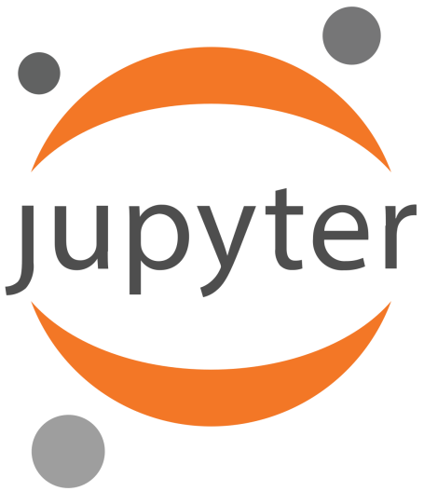
JUPYTER NOTEBOOK
JUPYTER stands for JUlia, PYThon, Ruby
Jupyter notebook is a open-sourced web-based application that allows interactive development in Python as well as over 40 other programming languages.
Features
Supports markdown and enables us to add HTML components from images to videos.
Can be integrated with cloud.

Slide 24
JUPYTER NOTEBOOK INSTALLATION
We can install Jupyter in two ways:
If Python standard IDE is already installed, using command line tool
command: pip install jupyter
Install through Anaconda
visit: https://www.anaconda.com/products/individual
Anaconda is a open source Python/R data science distribution package manager, an environment manager and has a collection of over 7,500+ open-source packages.

Slide 25
Program Statement
A computer program statement is a syntactic unit of an imperative programming language that expresses some action to be carried out by computer.
A computer program is formed by writing a sequence of one or more statements. A statement may have internal components.
In order to direct the actions performed by computer or to control the order of execution of actions there are many different types of statements:
Assignment statement
Input/output statement
Expression statement
Flow control statement
Etc..

